Slide 1

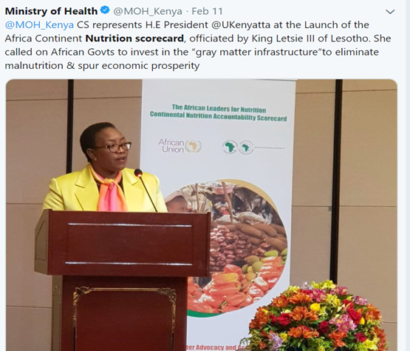
THE KENYA NUTRITION SCORECARD
The Kenya Nutritionn Information Technical Working Group (NITWG)

Slide 2

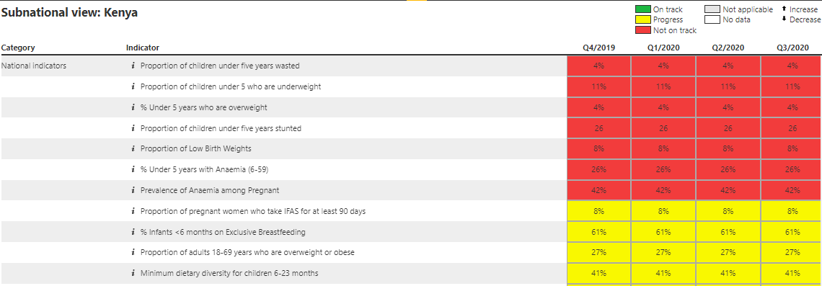

  Scorecard management tools support nutrition interventions and decision making:
    Providing an online management system to help countries track performance of key indicators and manage actions and workplans
    Using existing quarterly data to inform actions that address key emerging issues
    Facilitating action, accountability and advocacy at national, and sub-national levels through the action tracker and workplan functions, in addition to data visualization tools

Slide 3
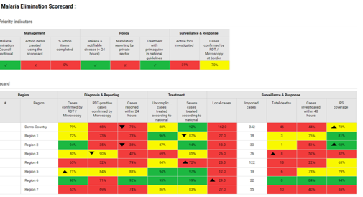
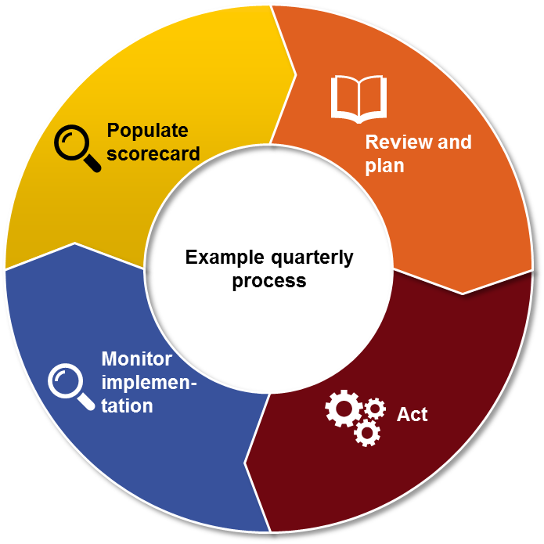
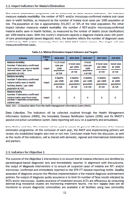
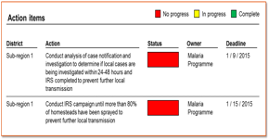

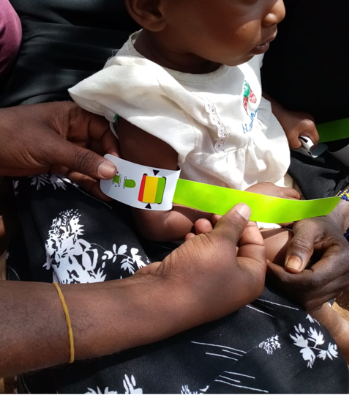
The scorecard supports and strengthens existing action and accountability mechanisms
?
Data from existing sources are populated in the scorecard
Existing management processes review the scorecard and document recommended actions in minutes and/or the action tracker
Existing accountability mechanisms monitor implementation and collect data
Programmes and partners implement recommended action items

Slide 4
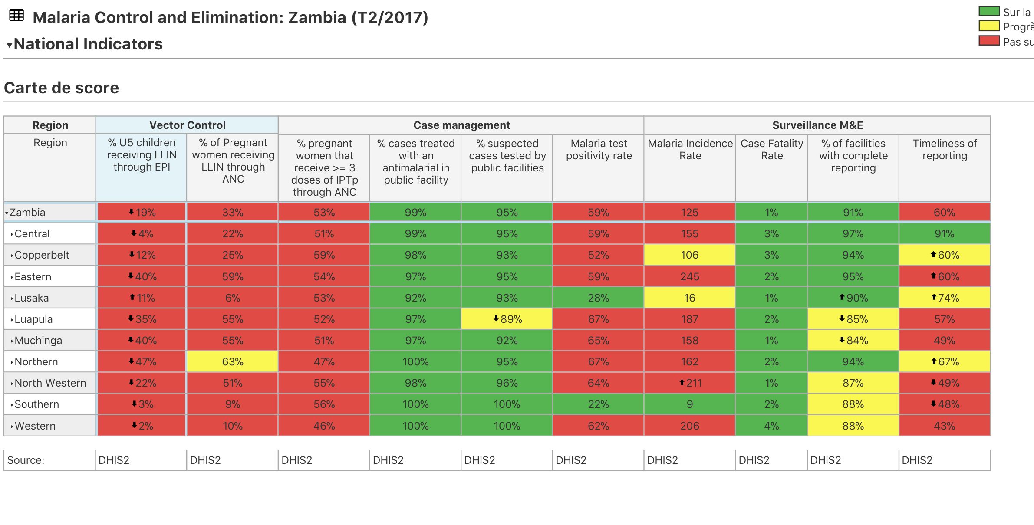
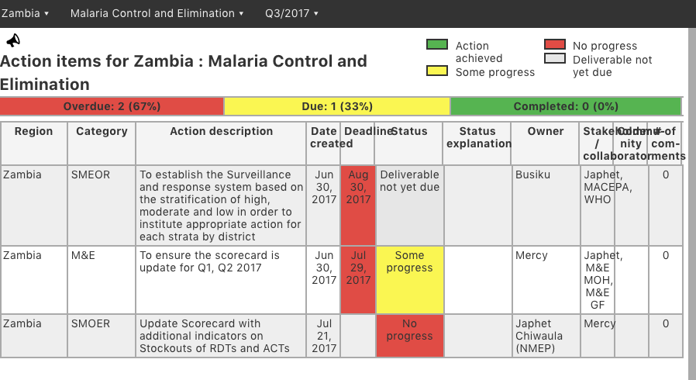
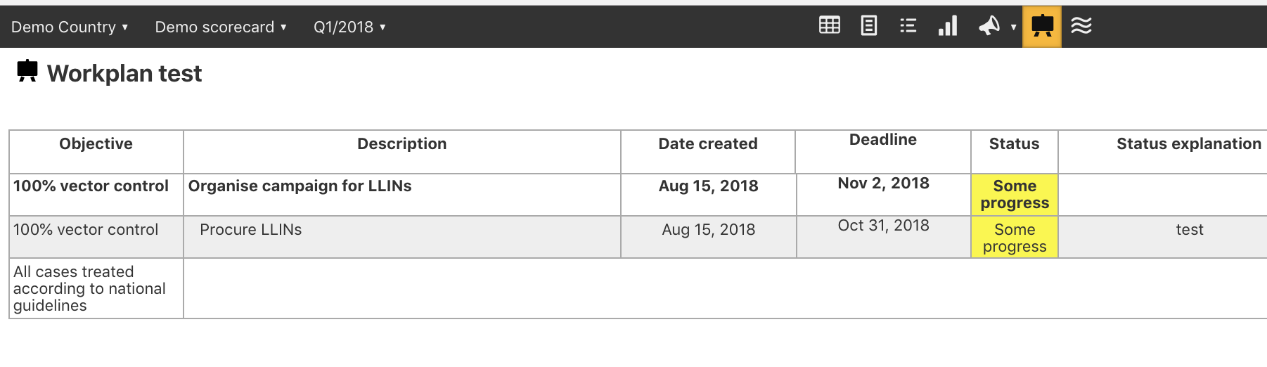
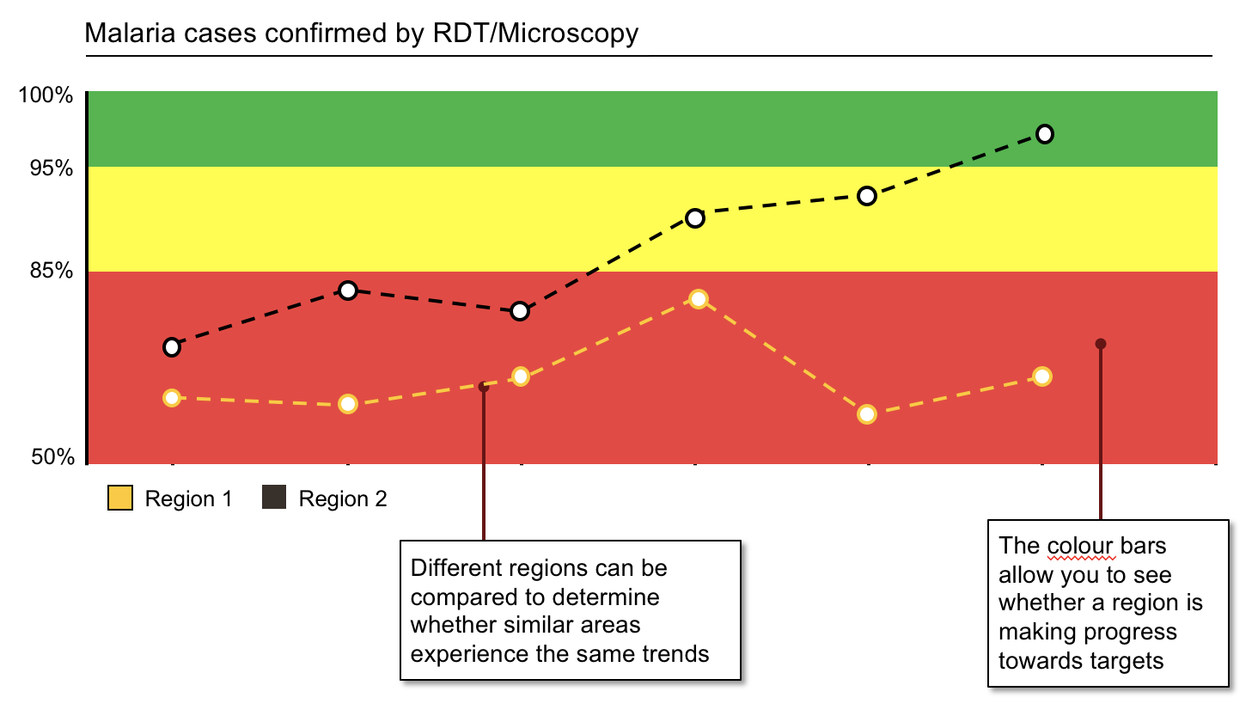

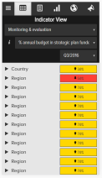
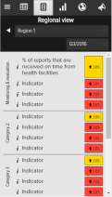
The online scorecard management tool (web platform) functionalities
Scorecard
Action tracker
Action tracker
Workplan manager
Mobile notifications
Data visualisation
What It is
What it is
What it is
What it is
What it is
Quarterly performance of priority indicators at national, regional and district level. Some scorecards include facility level data
Used to assign actions with deadlines to action “owners”. It includes a progress field showing implementation status and an automated notification system
Tracks implementation of annual workplans, listing key milestones and the progress of action items with clear owners and timelines, and an automated notification system
An automated SMS notification system alerts action owners on outstanding actions and approaching deadlines
Charts, maps, and other data visualisation tools provide additional context by showing indicator performance over time
Only users with accounts can access scorecards and management tools at www.rmncah.org

Slide 5


Each indicator has defined thresholds to indicate whether or not performance is on track.
Most countries align the “green” threshold with national targets
and the “red” threshold with the baseline
Thresholds are specific to each indicator and may change over time.
Green is usually aligned with the final target of the strategic plan.
Red is usually the baseline
  Red
Not on track (Example: < 55%)
Red-yellow threshold
  Yellow
Progress but more effort required
Yellow-green threshold
  Green
Target achieved (Example: > 95%)

Slide 6
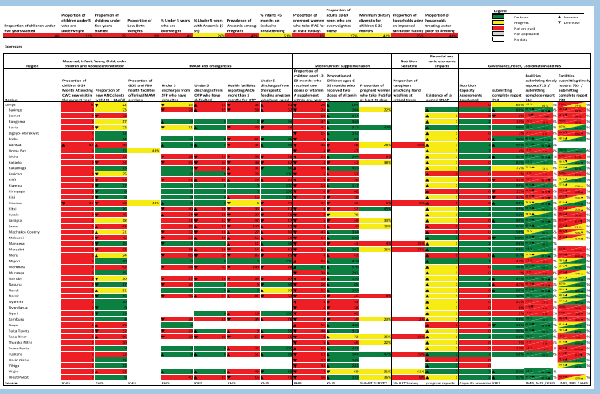
Why the Kenya Nutrition Scorecard
National level
  Identify challenges , best practices and cross learning; identify areas doing well and those with bottlenecks
  Trigger evidence based action and prioritization by Monitor program performance for county and national strategies
  Mutual accountability and dialogue with community : communities hold leaders accountable
  Track performance for KNAP 2018-22– measure progress of Key result Areas /targets
  Accountability, Transparency : leaders and service providers to improve nutrition outcomes in line with the constitution, VISION 2030, and Regional and Global commitments
  Advocacy and to highlight areas of need/success for national and county initiatives
National Level
County level

Slide 7

The Kenya Nutrition Scorecard Milestones
  In May 2019, the Division of Nutrition worked with MoH HIS , NITWG and partners (ALMA, UNICEF)
  Development Process–Participatory Representation
      Partners, National Programs, Counties
  The final result: Nutrition Scorecard –RMNCH platform spanning the KNAP Approach
          6 categories
          26 indicators: National (12) and County-level (14)
  Pilot Training
    In 2019 training- 19 counties and Partners
  Reviews, sensitization, utilization and documentation
  Launch 23rd September 2020
  Second country in Africa to develop a nutrition scorecard

Slide 8
Development of Kenya Nutrition Accountability Scorecard
Process
Step 3: Setting thresholds and prioritization of indicators
Step 4: Populated the scorecard
Step 1: Selected categories
Step 2: Selected indicators in each category
  Reviewed nutrition priorities and selected categories
    Maternal, Infant, Young Child, Older Children and Adolescent Nutrition
    Financial and socio economic impacts
    Micronutrient supplementation
    Governance, Policy, Coordination and NIS
    Nutrition Sensitive
    National level: impact/outcome level
  Identified priority indicators:
  Strategic plans: FSNP-IF, KNAP, KHSSP, CNAPS
  Life cycle approach
  Nutrition specific and sensitive indicators
  30 priority indicators identified
    13 national: impact/outcome level
    17 subnational level and country aggregates
  Identified performance color thresholds
  Based on country/county targets.
  Prioritized indicators based on data availability: 26 indicators identified
  Populated the scorecard tool data
  DHIS, survey reports and program reports

Slide 9
The Kenyan Nutrition scorecard indicators
Indicator
Under 5 years wasting
Under 5 years Underweight
Under 5 years Stunting
Under 5 Overweight
Low Birth Weight
Under 5 years Anaemia (6-59months)
Prevalence of Aneamia among pregnant women
% of pregnant women who take IFAS for at least 90 days
% of infants <6months on exclusive breastfeeding
% of adults 18-69 years who are overweight or obese
Minimum dietary diversity for children 6-23 months
% of households using an improved sanitation facility
National Category

Slide 10
The Kenyan Nutrition scorecard indicators
Sub National Categories and Indicators
Maternal, Infant, Young Child, older children and Adolescent nutrition
IMAM and Emergencies
Micronutrient supplementation
  Under 5 who are attending CWC for growth monitoring for the first time during the calendar year
  Proportion of new ANC clients with HB < 11g/dl
  Under 5 discharges from SFP who have defaulted
  Under 5 discharges from OTP who have defaulted
  Health facilities reporting ALOS more than 2 months for OTP
  Under 5 discharges from therapeutic feeding program cured
  % of children aged 12-59 months who received two doses of vitamin A supplement within one year
  % of Children aged 6-59 months who received two doses of Vitamin A
  Proportion of pregnant women who take IFAS for at least 90 days

Slide 11
The Kenyan Nutrition scorecard indicators
Sub National Categories and indicators
Financial and socio-economic impacts
Nutrition Sensitive
Governance, Policy, Coordination and NIS
  Proportion of caregivers practicing handwashing at critical times
Nutrition Capacity Assessments Conducted
Facilities submitting timely reports / submitting complete report 713 and 733
Existence of Costed CNAP

Slide 12
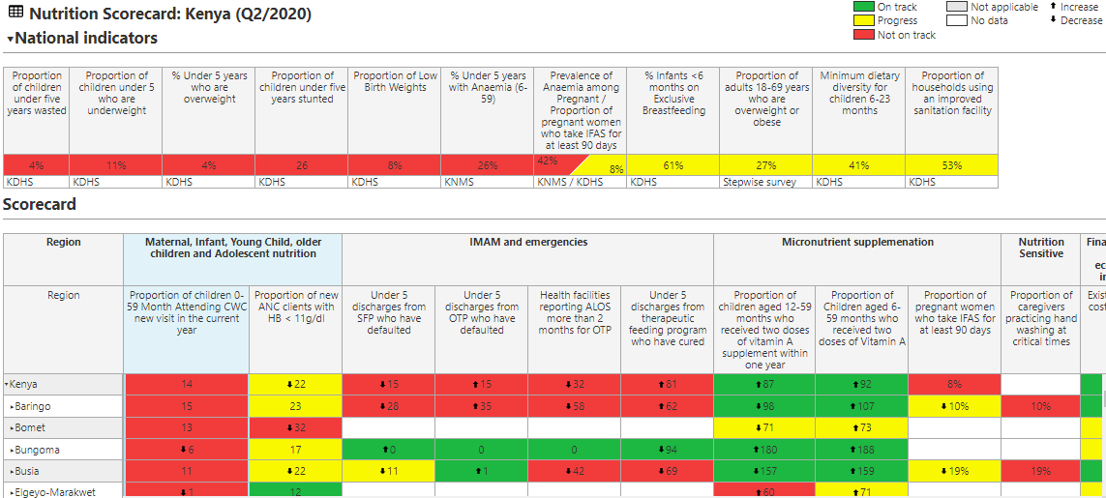
KENYA NUTRITION SCORECARD: (Q2/2020)

Slide 13
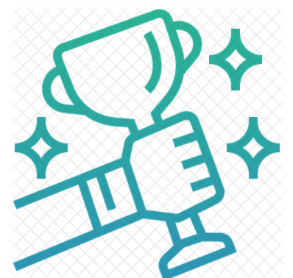

Development Process- Experiences
Success
Development of country Nutrition scorecard (26 indicators)
Training and roll out to 19 counties
Counties updating the nutrition scorecard up to facility level
Challenges
Data gaps and quality of data available from routine system
Difficulties in setting some of the thresholds due to wide variation of county performance & lack of global thresholds
Key learning from counties
The scorecard stimulate discussions – data gaps, tools availability, deep dive Marsabit –; Flagging ‘data speaks’
Capacity strengthening to sustain use of the tool
Mobilize resources to support more sensitization and Training
    Kisumu, Kilifi and Marsabit
Strengthening of existing tools and mechanisms and highlighting need for more data and better quality data
Ownership- wide dissemination - various stakeholders to facilitate action

Slide 14


Next Steps
    Roll out the scorecard to 28 counties up to sub-county levels and promote wide dissemination
  Tracking of performance and actions through visualization and action tracking functionalities for review . Publish the scorecard promote mutual dialogue among all key actors
    Advocate for National /County level documentation of experiences and best practices across to promote cross learning

Slide 15









Acknowledgement

Slide 16
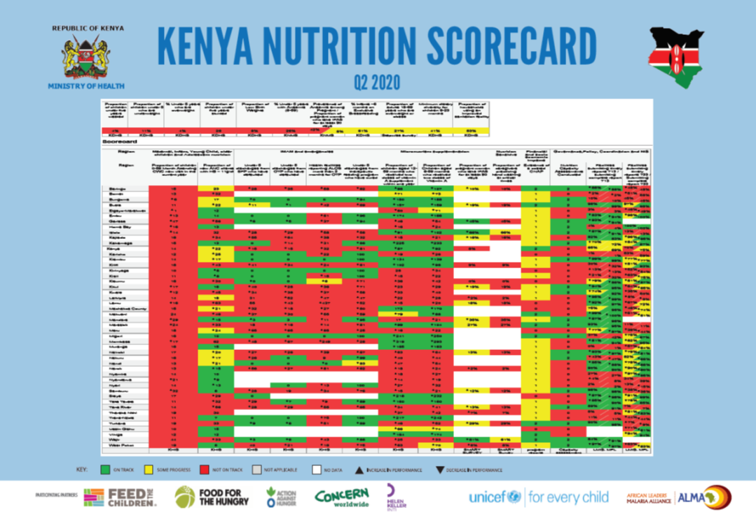

Thank you for listening

